Slide 1




REVA HACK 2023
TECHNOLOGY BEYOND IMAGINATION
Partnered with:
Powered by:

Slide 2
PROJECT TITLE : ANVESAN
TEAM NAME: SHOW_STEALERS
TEAM LEAD : Abhishek Belagavi (abhishekbelagavirb@gmail.com)
TEAM MEMBERS :
1. Shreya V Upadhyaya (8123661332, supadhya002@gmail.com)
2. Tejas A G (8867396980, tejasag88@gmail.com)
3. Jeevitha M J (9380080508,jeevithamj27@gmail.com)
4. Kavya Hegde (6360328748, hegdekavya02@gmail.com)

Slide 3
PROBLEM STATEMENT :
Revolutionizing Missing Persons/Children Tracking with Aadhaar-Enabled Biometric Technology

Slide 4
METHODOLOGY:
If you find someone, Open our website
Collect information like Fingerprint or image
Our portal will do the Face recognition or will given the persons detail by matching the fingerprint
Help person meet their loved ones
Key Points:
Any normal person can use the portal
2 options:
Take a picture of the victim
Use the fingerprint
Unsupervised Machine Learning Algorithm for Facial recognition
OpenCV for Fingerprint detection

Slide 5
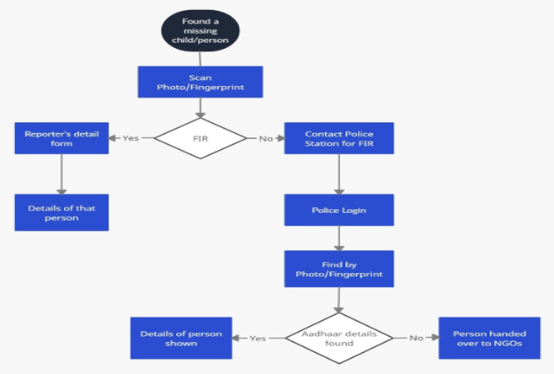







FLOWCHART AND TECHNOLOGY USED
Machine Learning Model:
Face Recognition & Fingerprint
2. Image Processing:
Face Recognition
3. Python:
Machine Learning & Deep Learning
4. HTML/CSS/JS:
Frontend
5. SQLite 3:
Hashing & Authentication
6. MongoDB:
Database
7. Flask:
Backend

Slide 6
USABILITY/IMPACT
We're driven by innovation, making FindTheMissing a cutting-edge solution that goes beyond traditional approaches to solving the problem of missing persons.
We bridge public-law enforcement collaboration to fast-track missing person searches, making us the most effective choice for this challenge.

Slide 7
CONCLUSION
“ Tech-driven hope: Reuniting the missing “

Slide 8

THANK YOU

